Slide 1
chapter 1:Introduction of OOP
overview of oop
Object-Oriented Programming (OOP) is a programming paradigm that organizes code into objects, which are instances of classes.
Here are some key concepts and principles of Object-Oriented Programming:
Class: A blueprint or template for creating objects. It defines the properties and behaviors common to all objects of a certain kind.
Object: An instance of a class. It is a concrete entity created based on the class definition.
Encapsulation:refers to the bundling of data (attributes) and the methods (functions) that operate on that data into a single unit, i.e., a class. It helps in hiding the internal details of an object and exposing only what is necessary.

Slide 2
Continued…
Inheritance: is a mechanism that allows a new class (subclass or derived class) to inherit properties and behaviors of an existing class (base class or parent class). This promotes code reuse and establishes a relationship between classes.
Polymorphism: allows objects of different types to be treated as objects of a common base type. It enables a single interface to represent different types and is often expressed through method overriding and interfaces.

Slide 3
Continued…
java is a high-level, object-oriented programming language that was developed by Sun Microsystems and released in 1995.
It is designed to be platform-independent, meaning that Java programs can run on any device that has a Java Virtual Machine (JVM) installed, regardless of the underlying hardware and operating system.
Java technology applications are typically general-purpose programs that run on any machine where the Java runtime environment (JRE) is installed.
Java Technology mainly consists two parts
  JDK
  JRE.

Slide 4
Java Development Kit (JDK)
JDK is A free software development package from Sun Microsystems that implements the basic set of tools needed to write, test and debug Java applications and applets.
  i.e. JDK is Java Software Development kit (SDK)
It is the toolkit for developers that includes the Java compiler and the runtime environment.
To write Java programs, you need the JDK installed in the PC.

Slide 5
JDK Editions
Java Standard Edition (J2SE)
  J2SE can be used to develop client-side standalone applications or applets.
Java Enterprise Edition (J2EE)
  J2EE can be used to develop server-side applications such as Java servlets and Java ServerPages.
Java Micro Edition (J2ME)
  J2ME can be used to develop applications for mobile devices such as cell phones.

Slide 6
Java Runtime Environment (JRE)
JRE is the program that emulates the JVM, so that users can run Java programs.
To run Java programs, you need download and install the JRE.
Runs code compiled for a JVM and performs class loading (through the class loader), code verification (through the bytecode verifier) and finally code execution.
The major component of JRE are
  Java platform core classes libraries
  Java virtual machine (JVM)

Slide 7
Why Java?
java is a popular and widely used programming language for various reasons. Here are some key factors that contribute to Java's popularity
Platform Independence:Java programs are compiled into an intermediate bytecode that can be executed on any device with the Java Virtual Machine (JVM).
Object-Oriented Paradigm:It follows OOP principles such as encapsulation, inheritance, and polymorphism, making it easier to design, develop, and maintain complex software systems.
Rich Standard Library:it provides a wide range of classes and methods for common programming tasks.
Strong Community Support:Java has a large and active developer community. This community support is valuable for sharing knowledge, troubleshooting issues, and contributing to the growth of libraries, frameworks, and tools.

Slide 8
Features of Java
simple
Here are some aspects highlighting why Java is often considered a simple language:
Syntax Similar to C++
No Pointers
Standard Libraries:Java comes with a rich set of standard libraries that provides pre-built functionalities for common tasks, reducing the need for developers to write code from scratch.
Platform Independence:Java's "Write Once, Run Anywhere" (WORA) principle allows Java programs to run on any device with a Java Virtual Machine (JVM), making it easier to deploy applications across various platforms.
Exception Handling:Java has a robust exception-handling mechanism that helps developers identify and manage errors effectively, improving the reliability of Java programs.

Slide 9
Object oriented
focus on the data (objects) and methods manipulating the data
all functions are associated with objects
almost all datatypes are objects (files, strings, etc.)
potentially better code organization and reuse
Interpreted
java compiler generate byte-codes
the compiled byte-codes are platform-independent
java bytecodes are translated on the fly to machine readable instructions in runtime (Java Virtual Machine)

Slide 10
Multithreaded
Java provides support for concurrent execution of multiple threads within a single program.
Thread Class:Java represents threads using the Thread class. Developers can create threads by extending the Thread class or implementing the Runnable interface.
Concurrency and Parallelism:Java supports both concurrency and parallelism. Concurrency refers to the ability of different parts of a program to execute independently, while parallelism involves executing multiple threads simultaneously.
Thread Lifecycle:Java threads go through various states in their lifecycle, including NEW, RUNNABLE, BLOCKED, WAITING, TIMED_WAITING, and TERMINATED. Developers can control the execution of threads using methods provided by the Thread class.

Slide 11
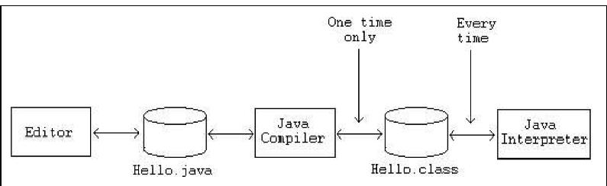
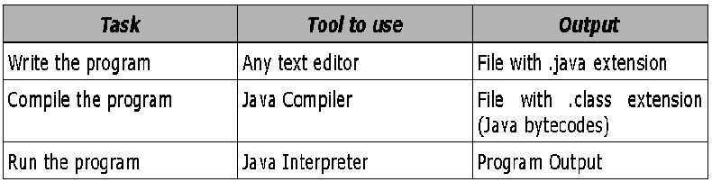
Phases of a Java Program
Java programs normally go through five phases – edit, compile, load, verify and execute

Slide 12
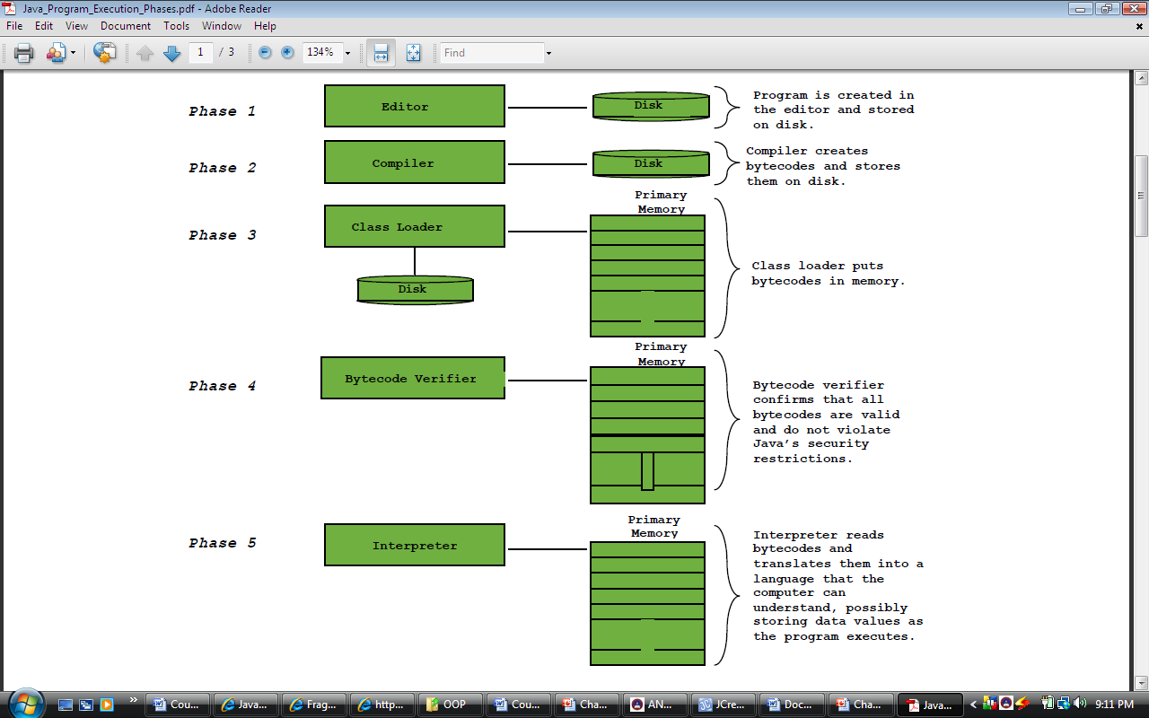

Slide 13
Phase 1: Creating a program
Involves editing a file with an editor
The following are some Java Integrated Development Environments (IDEs).
  Jbuilder, NetBeans , Sun ONE Studio, Eclipse, jEdit, Jcreator, BlueJ, jGRASP, etc.
  Most of this editors can be downloaded for free.
  Any text editor can also be used for creating Java programs.
  Programs written on IDEs or any other editors are known as Source Code.
  Java source code file names end with .java extension

Slide 14
Phase 2: Compiling Java Programs into Bytecodes
Since a computer cannot understand a source program, program called a compiler is used to translate the source program into a machine language program called an object program.
With Java, you write the program once, and compile the source program into a special type of object code, known as bytecode.
The bytecode can then run on any computer (platform) with a Java Virtual Machine

Slide 15
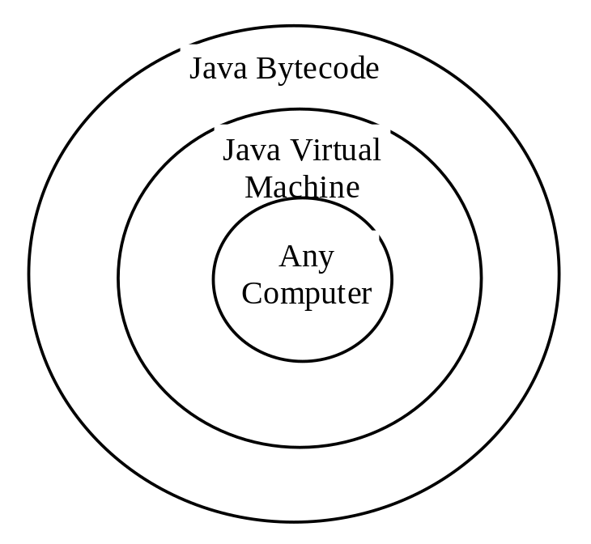
Continued…
A virtual machine is a software application that simulates a computer-JVM is one of the most widely used virtual machine
Java Virtual Machine, which is part of JRE, is a software that interprets Java bytecode.
To compile Java Program
  Javac welcome.java
To execute java programs
  Java welcome

Slide 16
Continued…
Runs on
Windows PC
Running JVM
Code
Compile
Result
Java Program
(*.java)
Java Compiler
javac
Java Byte code
(*.class)
UNIX
Running JVM
Macintosh
Running JVM

Slide 17
Phase 3: Loading a program
A program must be placed in memory before it can execute : a process known as loading.
The class loader takes the .class file (produced during compilation process) containing the program’s bytecodes and transform them to primary memory.
The class loader also loads any of the .class files provided by java that your program uses.
The .class files can be loaded from a disk on your system or over a network

Slide 18
Phase 4 : Bytecode Verification
Involves examining bytecodes to ensure that they are valid and do not violate Java’s security restriction.
Java enforces strong security, to make sure that Java programs arriving over the network do not damage your files or your system (as computer viruses and worms might)

Slide 19
Phase 5: Execution
The JVM executes the program’s bytecodes, thus performing the actions specified by the program.
.class file is not final machine code yet. It is virtual machine code. JVM need a second compilation to convert virtual machine code to real machine code. We call it just-in-time compiler (JIT).
This greatly affects the speed of the execution.
Traditionally, our C/C++ program can finish all the compilation before execution. The generated machine code could run directly on OS or hardware

Slide 20
A Simple Java Program
The following code is a java program that prints the string “ Welcome to Java”. Now lets make a line by line investigation of the program
/* Your first Java program; Welcome.java
The program prints a string Welcome to Java Programming
*/
public class Welcome {
//main method begins execution of Java application
public static void main (String args[])
{
System.out.println(“Welcome to Java”);
}//end of main method
} //end of class Welcome

Slide 21
Continued…
Lines 1-3 & 5 comment lines
There are two types of comments in Java
  End-of-line (Single line) comments
    A line that begins with //
  Traditional (Multiple line ) Comments
    A text that begins in /* ends in */
    All text between these delimiters is comment so it is ignored by the compiler.
    These comment can be applied for a line, more than a lines or part(s) of a line

Slide 22
Continued…
  Javadoc comments
    A text that begins in /** and ends in*/
    As with traditional comments, all text between the Javadoc comment delimiters is ignored by the compiler.
    Javadoc comments enable programmers to embed program documentation directly in their programs.

Slide 23
Continued…
Line 4: public class Welcome {
  This line begins class declaration of the class Welcome.
  Every program in Java consists of at least one class declaration .
  Generally, Java class declaration has the following format:
    [Access level Specifier] class class_name { … }

Slide 24
Continued….
The class is the essential Java construct. A class is a template or blueprint for objects.
To program in Java, you must understand classes and be able to write and use them.
The mystery of the class will continue to be unveiled throughout this course. For now, though, understand that a program is defined by using one or more classes.

Slide 25
Continued…
Access level Specifier
  Could be omitted (none), public, private, or protected
  These are keywords that help to set the visibility and accessibility of a class, its member variables, and methods.
  They determine whether a field or method in a class, can be used or invoked by another method in another class or sub-class.

Slide 26
Continued…
class
  The class keyword introduces a class declaration in Java and is immediately followed by the class name (Welcome).
class_Name
  Is the name of a class. A Java class name is an identifier.
  By convention class names should start with capital letters
  Java is case Sensitive

Slide 27
Continued…
Line 6: public static void main(String args[])
  Is a method of which the starting point of every java application.
  Every Java application must contain one main method.
  public is a keyword which specifies access level of the method.
  The JVM executes the application by invoking the main method

Slide 28
Continued…
  static is another keyword which allows main( ) to be called without having to instantiate a particular instance of the class.
  void is a return type that indicates that this method performs a task but will not return any information when it completes its task.
  String args[] … is an array of strings which is an argument of the main function.

Slide 29
Continued…
Line 7: System.out.println( "Welcome to Java Programming!" );
  This line prints the string contained in quotation.
  System.out is known as the standard output object.
  When System.out.println completes its task, it positions the output cursor (the location where the next character will be displayed) to the beginning of the next line while System.out.print don’t.
    Every statement of java must end in semicolon (;) so is line 7
Lines 8 and 9
  This line depicts the end of the main method and the class welcome.

